Slide 1

scanner data hackathon

Slide 2
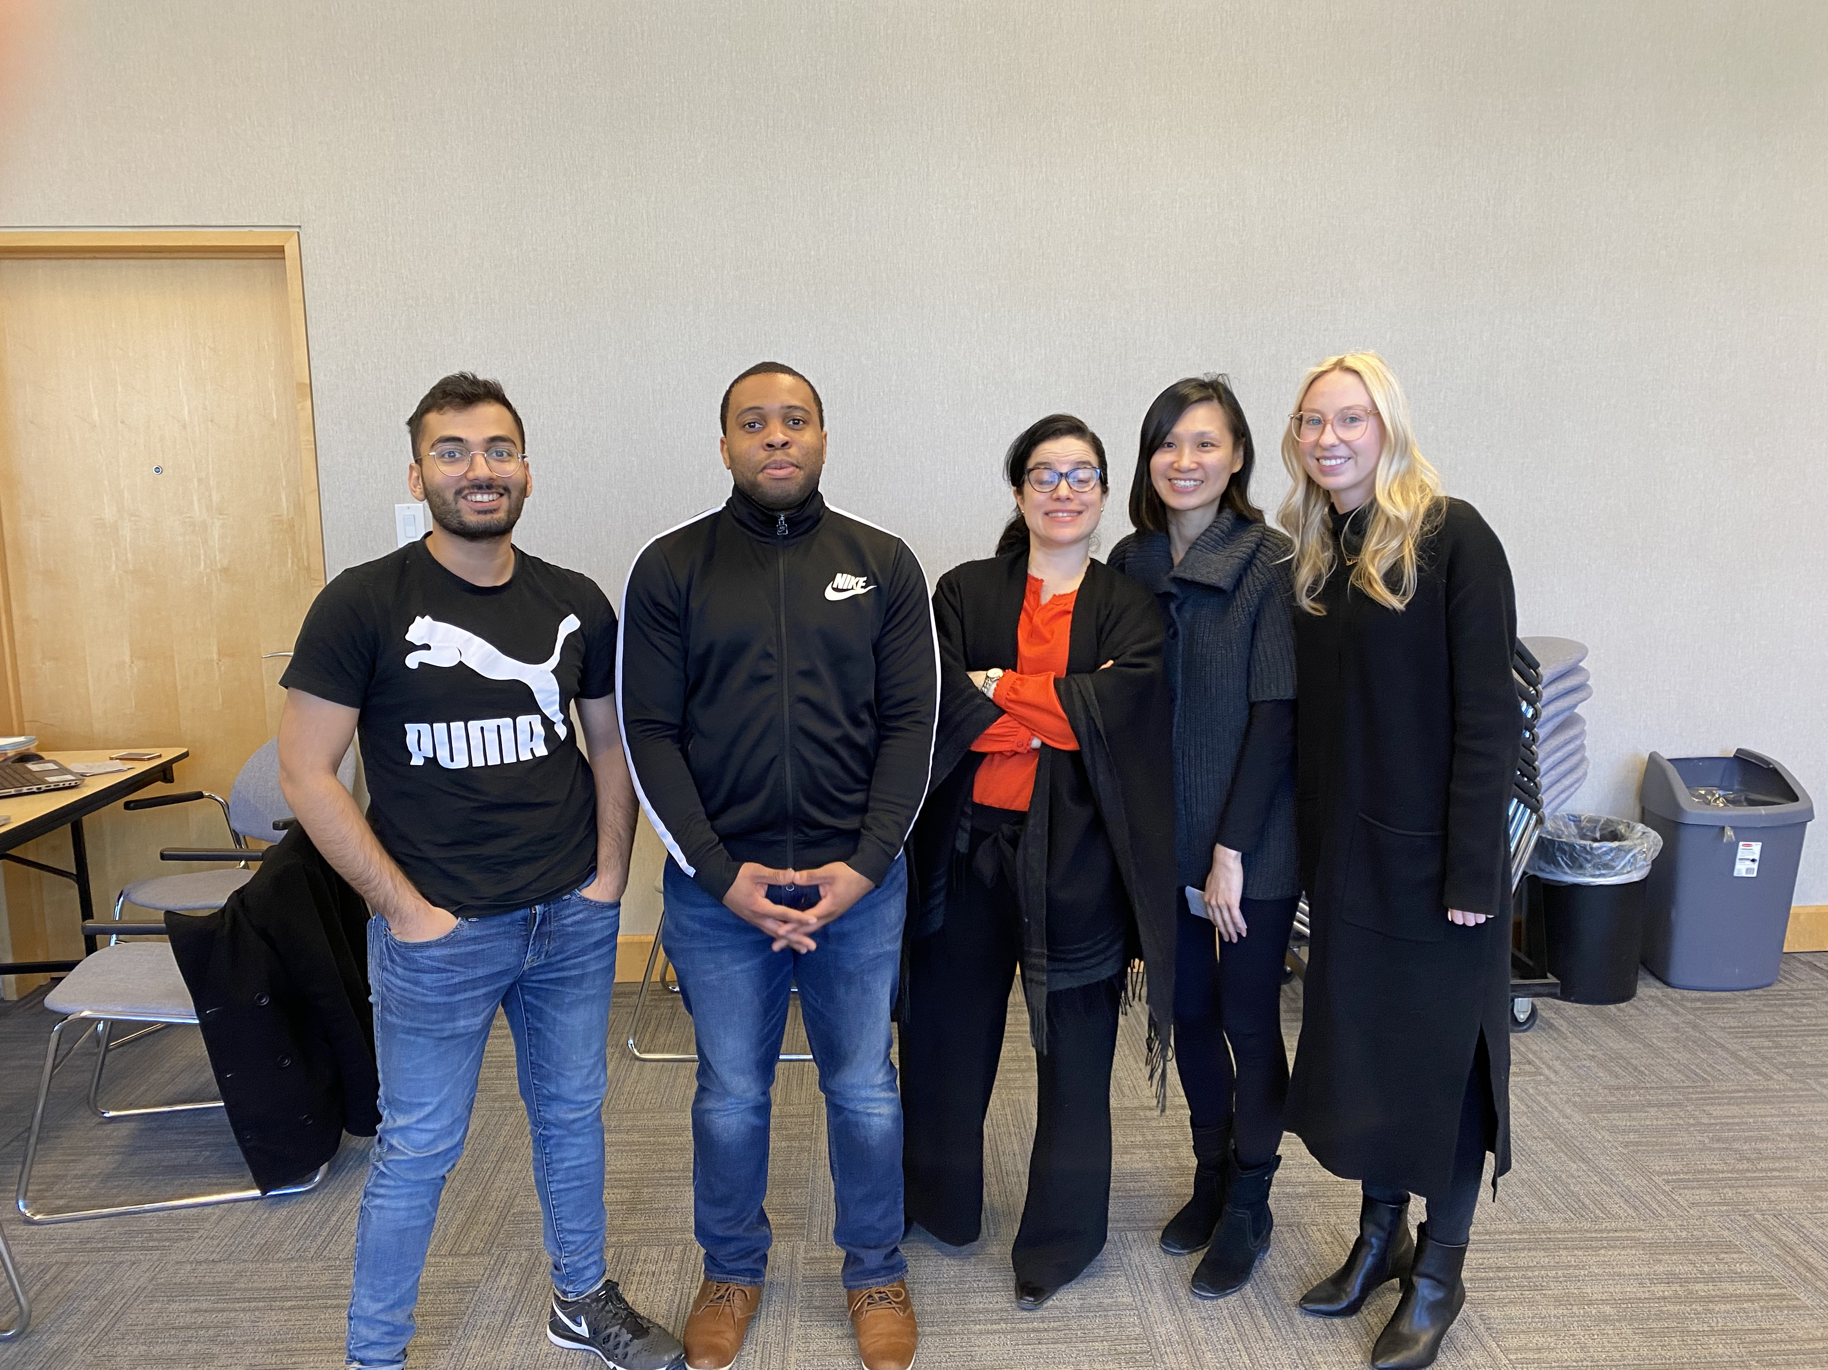
hello!
we are team 5 (6ixStatz)
Abigail Stewart, Maria Lorena Mari Del Cristo, Vivien Lee, Shahzeb Afroze, Grace Wei, Edima Udo

Slide 3
solutions
1)
+
2)
internal
external

Slide 4
internal solution
1

Slide 5
timeliness
an important goal within Retail and Service Industry Division (RSID) is timeliness
we need to enhance the turn-around of our survey estimates without sacrificing quality
having access to scanner data is a step in the right direction
improving our technology and speeding up processes is crucial

Slide 6
accelerated production cycle
to produce results faster within RSID, we have created a program; analyst assistant that combs through the scanner data
as analysts, we manually check these parameters to detect outliers…
+/- 50% or more change in sales, month over month change & year over year change
changes in # of locations
openings and closures of locations
Notes:
To improve timeliness within RSID, we have created a program that combs through the data.

Slide 7
Every analyst deserves an assistant - 6ixStatz

Slide 8
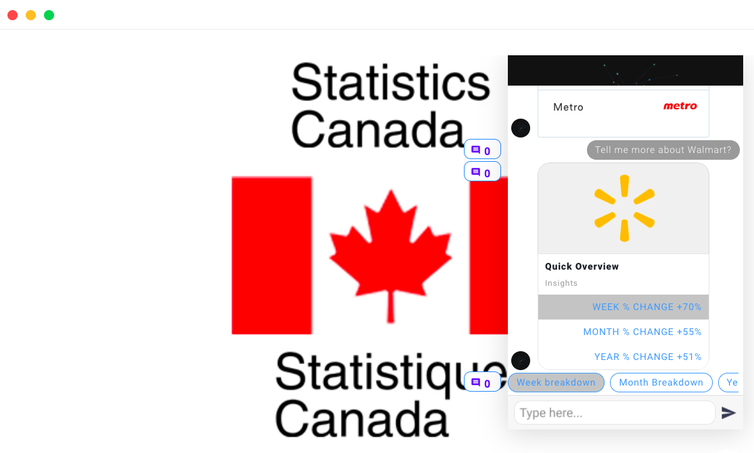
Place your screenshot here
analyst assistant
encourages the use of scanner data, by allowing us to analyze an abundance of data in a short period of time

Slide 9
Place your screenshot here
analyst assistant
automated outliers detection
optimized breakdown
data preparation
Demo

Slide 10
external solution
2

Slide 11
retail sales dashboard
trending goods and services
product analysis
retail sales drill-down
market concen-tration
retailer perfor-mance
establish-ment birth and death
store traffic, average sales, items per purchase, returns as % of sales
aggregate data by industry / sector
product sales relative to total retail sales, sales trend by geographical location/income/demographic characteristics
implications for retailers and government policies

Slide 12
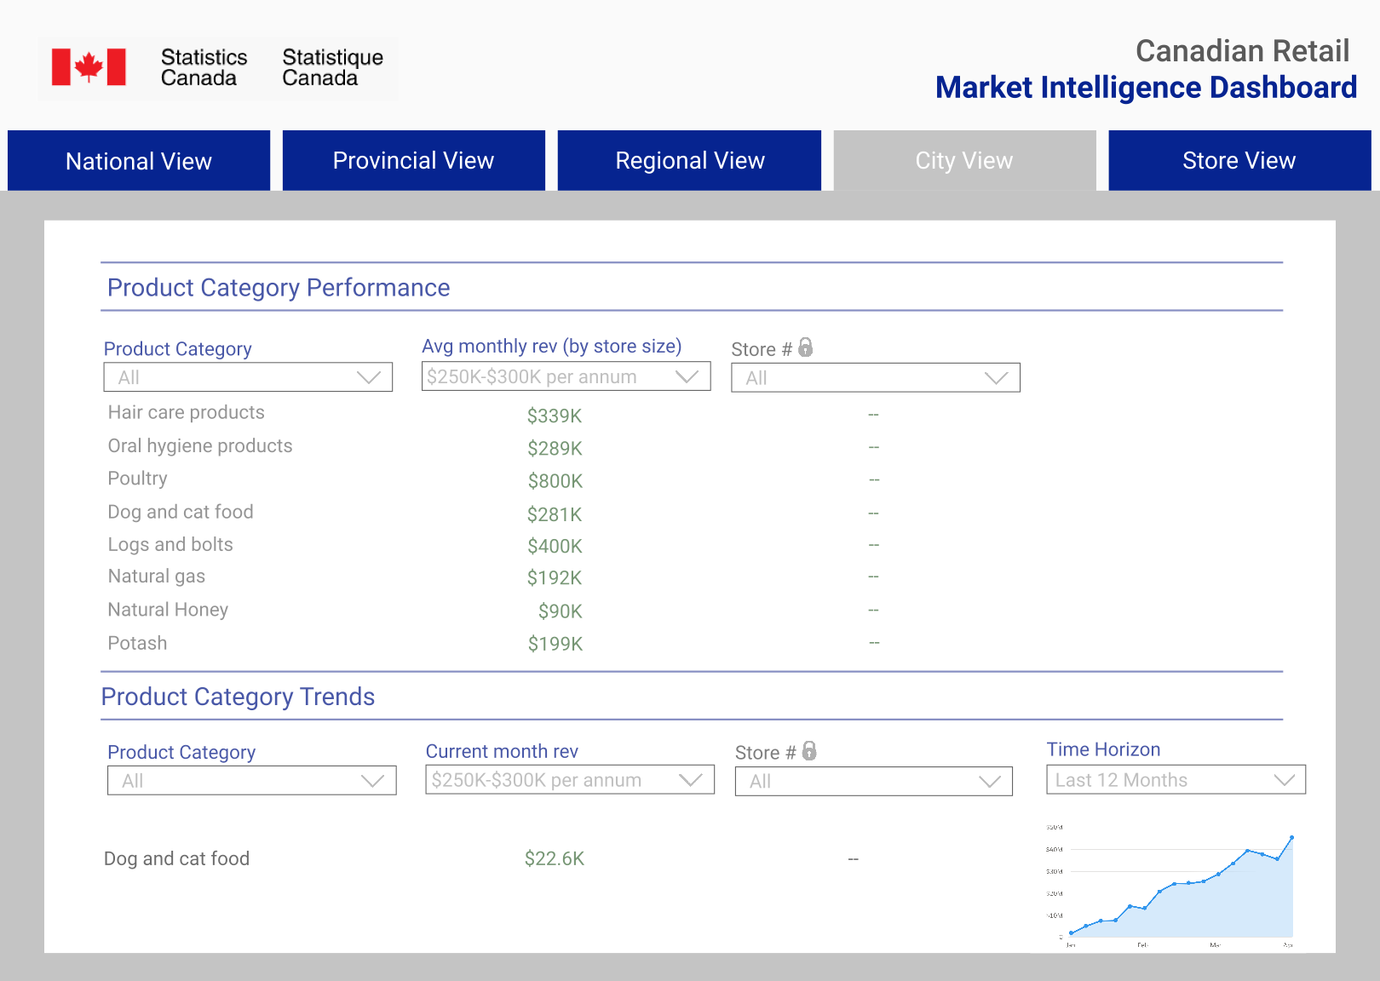
Place your screenshot here
retail sales dashboard
offering data visualisation on-the-go
password protected

Slide 14
take-aways
analyst assistant
improve productivity
reduce data burden to focus on tasks such as macro-economic analysis, custom requests
using analyst assistant can help us speed up the production cycle
robust capacity
retail dashboard
ability to handle growing scanner data contracts
offering data visualisation on- the-go

Slide 15
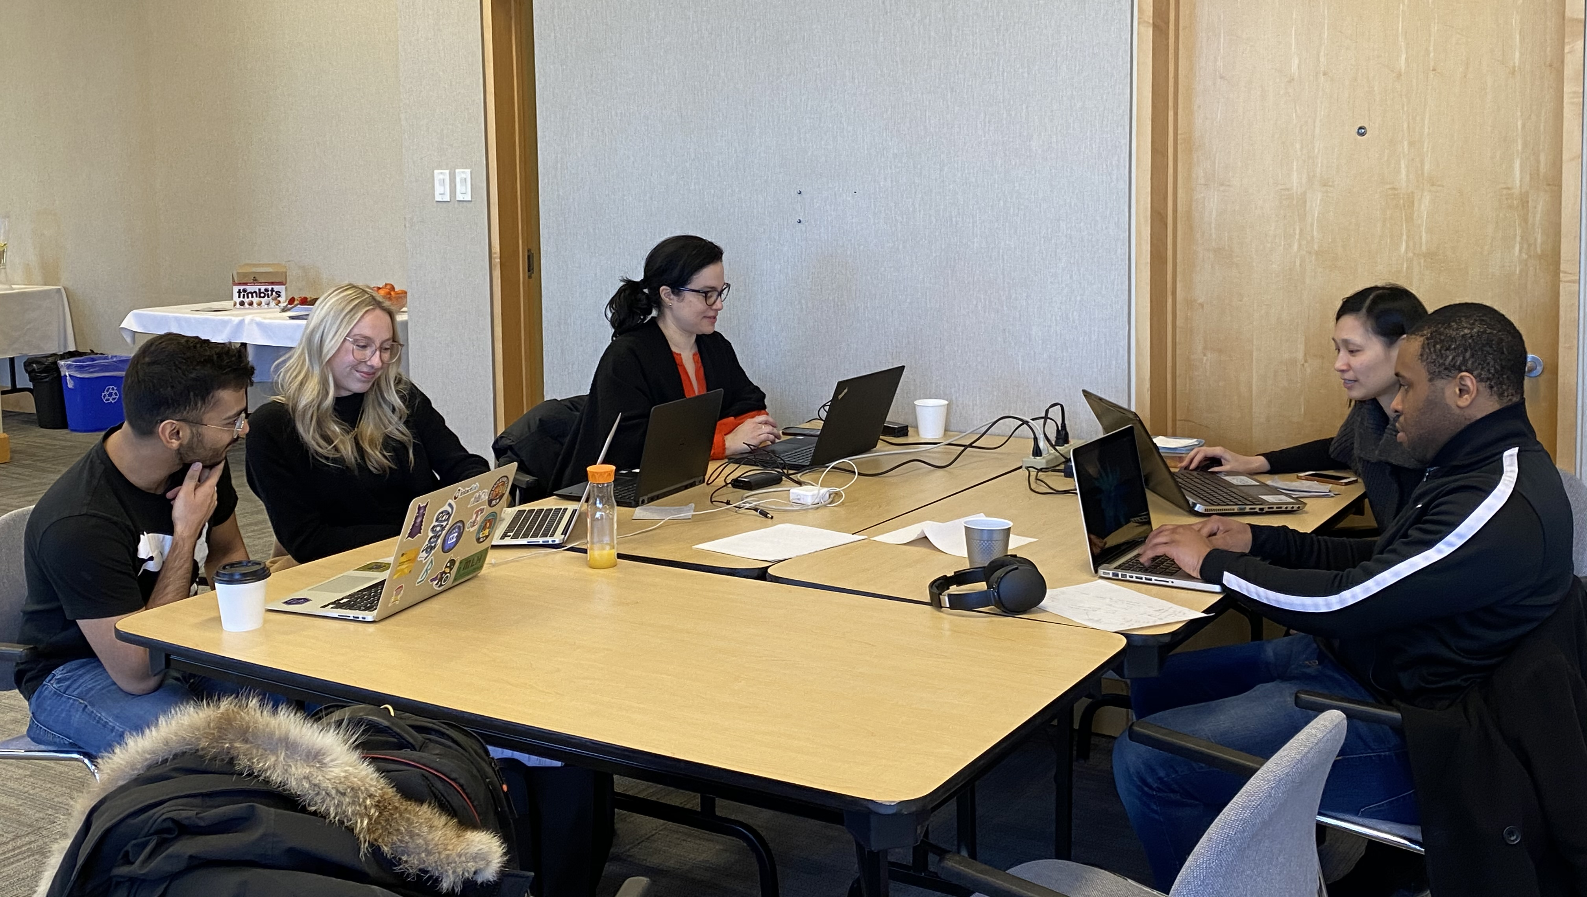
THANKS!
Any questions?

